Slide 1
Module 2
Data and Sampling Distributions
By Sunil Naidu G R

Slide 2
The figure left-hand side represents a population that, in statistics, is assumed to follow an underlying but unknown distribution. All that is available is the sample data and its empirical distribution, shown on the right-hand side. To get from the left-hand side to the righthand side, a sampling procedure is used (represented by an arrow). Traditional statistics focused very much on the left-hand side, using theory based on strong assumptions about the population. Modern statistics has moved to the right-hand side, where such assumptions are not needed.
The simplest example is flipping a coin: this follows a binomial distribution. Any real-life binomial situation (buy or don’t buy, fraud or no fraud, click or don’t click) can be modeled effectively by a coin (with modified probability of landing heads, of course). In these cases, we can gain additional insight by using our understanding of the population.
Definition: The Sampling is a statistical process of selecting few representatives from the population, called as a sample, on the basis of which the characteristics of the total population can be ascertained.
Population versus sample

Slide 3
Random Sampling and Sample Bias
A sample is a subset of data from a larger data set; statisticians call this larger data set the population. A population in statistics is not the same thing as in biology—it is a large, defined (but sometimes theoretical or imaginary) set of data.
Random sampling is a process in which each available member of the population being sampled has an equal chance of being chosen for the sample at each draw. The sample that results is called a simple random sample. Sampling can be done with replacement, in which observations are put back in the population after each draw for possible future reselection. Or it can be done without replacement, in which case observations, once selected, are unavailable for future draws.
Data quality often matters more than data quantity when making an estimate or a model based on a sample. Data quality in data science involves completeness, consistency of format, cleanliness, and accuracy of individual data points. Statistics adds the notion of representativeness.
Simple Random Sampling
Definition: The Simple Random Sampling is a sampling technique wherein every item of the population has an equal and likely chance of being selected in the sample. Here, the selection of the item solely depends on the chance and therefore, this method is also called as a Method of Chance Selection.

Slide 4
The most common method used to obtain the random samples from the population is a Lottery Method. Under this method, all the items of the population are numbered or named on the identical paper slips and then these slips are mixed up in a container. The investigators blindfold himself and select as many slips from the container that constitute the desired sample size.
Here, the selection is purely based on a chance and every item has an equal chance of getting selected. This method is very popular in the lottery draws. While using the lottery method, it is essential to check that the slips are of identical size, color, and the shape, otherwise, there is a possibility of personal bias and prejudice.
Stratified Sampling
Definition: The Stratified Sampling is a sampling technique wherein the population is sub-divided into homogeneous groups, called as ‘strata’, from which the samples are selected on a random basis.
The strata are formed on the basis of the member’s shared attributes and characteristics. These are mutually exclusive as every item of the population is assigned to a single stratum. The items should be selected from every stratum such that each element has the chance of being selected in a sample, with a probability close to 0.

Slide 5
Proportionate Stratified Sampling: In this method, the elements from each stratum is selected in proportion to the size of the strata. Hence, there is a same sampling fraction between the strata. For example, if the population is to be divided into five strata with respective sizes 10, 15, 20, 20, 35 percent of the population and the sample of 1000 is to be drawn, then the proportional sample will be obtained as follows
Stratum-1: 1000 (0.10) = 100 items
Stratum-2: 1000 (0.15) = 150 items
Stratum-3: 1000 (0.20) = 200 items
|Stratum-4: 1000 (0.20) = 200 items
Startum-5: 1000 (0.35) = 350 items
On adding the items drawn from each stratum we get the total sample size as 1000.
This method is useful only when there are no significant variations between strata.

Slide 6
Key Terms for Random Sampling
Sample
A subset from a larger data set.
Population
The larger data set or idea of a data set.
N (n)
The size of the population (sample).
Random sampling
Drawing elements into a sample at random.
Stratified sampling
Dividing the population into strata and randomly sampling from each strata.
Stratum (pl., strata)
A homogeneous subgroup of a population with common characteristics.
Simple random sample
The sample that results from random sampling without stratifying the population.
Bias
Systematic error.
Sample bias
A sample that misrepresents the population.

Slide 7

Famous Statistical Blunders in History
Literary Digest, 1936
In 1936, Literary Digest, a national magazine of the time, sent out 10 million "straw" ballots asking people to tell them who they planned on voting for in the 1936 presidential election. They received back 2.4 million ballots (not bad for a pre-internet time when polling was still in its infancy, but still only about a 25% return rate, which leaves the door open for voluntary response bias). They predicted Alf Landon would beat Franklin Delanor Roosevelt 57% to 43%. As it turned out, Roosevelt won 62% to 37%.
The Literary Digest opted for quantity, paying little attention to the method of selection.
They ended up polling those with relatively high socioeconomic status (their own subscribers, plus those who, by virtue of owning luxuries like telephones and automobiles, appeared in marketers’ lists). The result was sample bias; that is, the sample was different in some meaningful and nonrandom way from the larger population it was meant to represent. The term nonrandom is important—hardly any sample, including random samples, will be exactly representative of the population. Sample bias occurs when the difference is meaningful, and it can be expected to continue for other samples drawn in the same way as the first.

Slide 8
Bias
Statistical bias refers to measurement or sampling errors that are systematic and produced by the measurement or sampling process. An important distinction should be made between errors due to random chance and errors due to bias. Consider the physical process of a gun shooting at a target. It will not hit the absolute center of the target every time, or even much at all. An unbiased process will produce error, but it is random and does not tend strongly in any direction (see Figure 2-2). The results shown in Figure 2-3 show a biased process—there is still random error in both the x and y direction, but there is also a bias. Shots tend to fall in the upper-right quadrant.
2-2 Scatterplot of shots from a gun with true aim
2-3 Scatterplot of shots from a gun with biased aim

Slide 9
Bias comes in different forms, and may be observable or invisible. When a result does suggest bias (e.g., by reference to a benchmark or actual values), it is often an indicator that a statistical or machine learning model has been misspecified, or an important variable left out.
Random sampling is not always easy. Proper definition of an accessible population is key. Suppose we want to generate a representative profile of customers and we need to conduct a pilot customer survey. The survey needs to be representative but is labor intensive.
Selection Bias
Key Terms for Selection Bias
Selection bias
Bias resulting from the way in which observations are selected.
Data snooping
Extensive hunting through data in search of something interesting.
Vast search effect
Bias or non-reproducibility resulting from repeated data modeling, or modeling
data with large numbers of predictor variables.

Slide 10
Self-Selection Sampling Bias
The reviews of restaurants, hotels, cafes, and so on that you read on social media sites like Yelp are prone to bias because the people submitting them are not randomly selected; rather, they themselves have taken the initiative to write. This leads to self-selection bias—the people motivated to write reviews may have had poor experiences, may have an association with the establishment, or may simply be a different type of person from those who do not write reviews.
Note that while self-selection samples can be unreliable indicators of the true state of affairs, they may be more reliable in simply comparing one establishment to a similar one; the same self-selection bias might apply to each.
Size Versus Quality: When Does Size Matter?
In the era of big data, it is sometimes surprising that smaller is better. Time and effort spent on random sampling not only reduces bias but also allows greater attention to data exploration and data quality. For example, missing data and outliers may contain useful information. It might be prohibitively expensive to track down missing values or evaluate outliers in millions of records, but doing so in a sample of several thousand records may be feasible. Data plotting and manual inspection bog down if there is too much data.
So when are massive amounts of data needed?
The classic scenario for the value of big data is when the data is not only big but sparse as well. Consider the search queries received by Google, where columns are terms, rows are individual search queries, and cell values are either 0 or 1, depending on whether a query contains a term. The goal is to determine the best predicted search destination for a given query. There are over 150,000 words in the English language, and Google processes over one trillion queries per year. This yields a hugematrix, the vast majority of whose entries are “0.”

Slide 11
Regression to the Mean
Regression to the mean refers to a phenomenon involving successive measurements on a given variable: extreme observations tend to be followed by more central ones.
Attaching special focus and meaning to the extreme value can lead to a form of selection bias.
Sports fans are familiar with the “rookie of the year, sophomore slump” phenomenon.
Among the athletes who begin their career in a given season (the rookie class), there is always one who performs better than all the rest. Generally, this “rookie of the year” does not do as well in his second year. Why not?
In nearly all major sports, at least those played with a ball or puck, there are two elements that play a role in overall performance:
• Skill
• Luck
Regression to the mean is a consequence of a particular form of selection bias. When we select the rookie with the best performance, skill and good luck are probably contributing.
Regression to the mean is a consequence of a particular form of selection bias. When we select the rookie with the best performance, skill and good luck are probably contributing.
In his next season, the skill will still be there, but very often the luck will not be, so his performance will decline—it will regress. The phenomenon was first identified by Francis Galton in 1886 [Galton-1886], who wrote of it in connection with genetic tendencies; for example, the children of extremely tall men tend not to be as tall as their father

Slide 12
Galton’s study that identified the phenomenon of regression to the mean

Slide 13
Sampling Distribution of a Statistic
The term sampling distribution of a statistic refers to the distribution of some sample statistic over many samples drawn from the same population. Much of classical statistics is concerned with making inferences from (small) samples to (very large) populations.
Sample statistic
A metric calculated for a sample of data drawn from a larger population.
Data distribution
The frequency distribution of individual values in a data set.
Sampling distribution
The frequency distribution of a sample statistic over many samples or resamples.
Central limit theorem
The tendency of the sampling distribution to take on a normal shape as sample size rises.
Standard error
The variability (standard deviation) of a sample statistic over many samples (not to be confused with standard deviation, which by itself, refers to variability of individual data values).

Slide 14
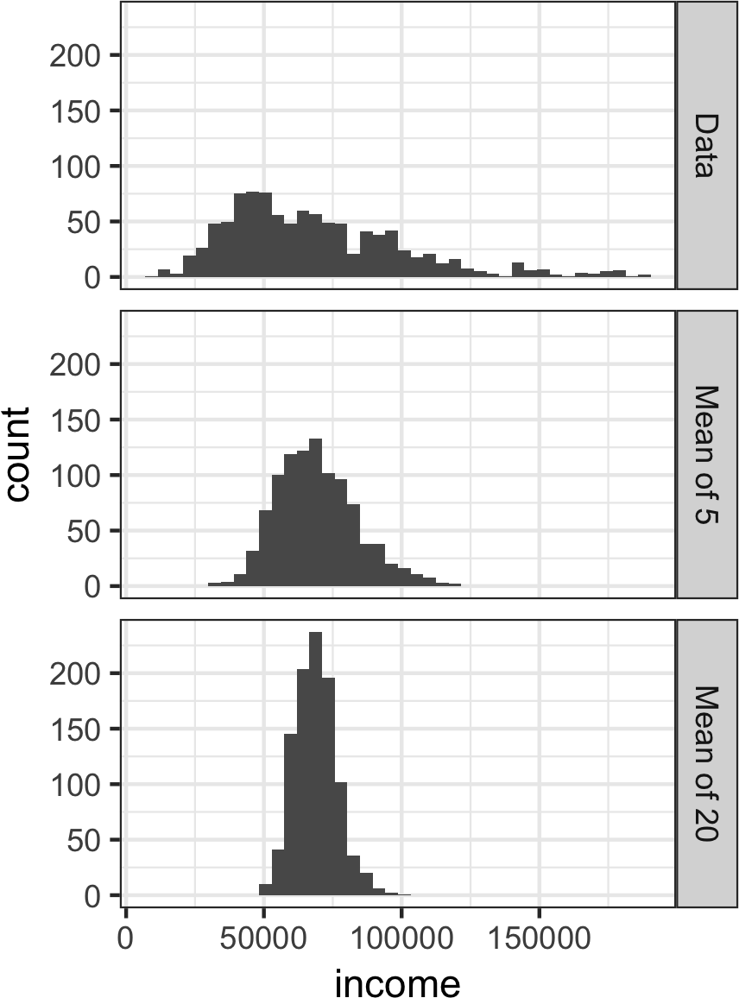
The distribution of a sample statistic such as the mean is likely to be more regular and bell-shaped than the distribution of the data itself. The larger the sample the statistic is based on, the more this is true. Also, the larger the sample, the narrower the distribution of the sample statistic.
This is illustrated in an example using annual income for loan applicants to Lending‐Club. Take three samples from this data: a sample of 1,000 values, a sample of 1,000 means of 5 values, and a sample of 1,000 means of 20 values. Then plot a histogram of each sample to produce Figure 2-6.
Figure 2-6. Histogram of annual incomes of 1,000 loan applicants (top), then 1,000 means of n=5 applicants (middle), and finally 1,000 means of n=20 applicants (bottom)

Slide 15
The Python code uses seaborn’s FacetGrid to show the three histograms:
import pandas as pd
import seaborn as sns
sample_data = pd.DataFrame({
'income': loans_income.sample(1000),
'type': 'Data',
})
sample_mean_05 = pd.DataFrame({
'income': [loans_income.sample(5).mean() for _ in range(1000)],
'type': 'Mean of 5',
})
sample_mean_20 = pd.DataFrame({
'income': [loans_income.sample(20).mean() for _ in range(1000)],
'type': 'Mean of 20',
})
results = pd.concat([sample_data, sample_mean_05, sample_mean_20])
g = sns.FacetGrid(results, col='type', col_wrap=1, height=2, aspect=2)
g.map(plt.hist, 'income', range=[0, 200000], bins=40)
g.set_axis_labels('Income', 'Count')
g.set_titles('{col_name}')

Slide 16
Central Limit Theorem
The phenomenon we’ve just described is termed the central limit theorem. It says that the means drawn from multiple samples will resemble the familiar bell-shaped normal curve . even if the source population is not normally distributed, provided that the sample size is large enough and the departure of the data from normality is not too great. The central limit theorem allows normal-approximation formulas like the t-distribution to be used in calculating sampling distributions for inference—that is, confidence intervals and hypothesis tests.
The central limit theorem receives a lot of attention in traditional statistics texts because it underlies the machinery of hypothesis tests and confidence intervals, which themselves consume half the space in such texts. Data scientists should be aware of this role; however, since formal hypothesis tests and confidence intervals play a small role in data science, and the bootstrap (see “The Bootstrap”) is available in any case, the central limit theorem is not so central in the practice of data science.
Standard Error
The standard error is a single metric that sums up the variability in the sampling distribution for a statistic. The standard error can be estimated using a statistic based on the standard deviation s of the sample values, and the sample size n:
Standard error = SE = s/(n)^1/2
As the sample size increases, the standard error decreases, corresponding to what wasobserved in Figure 2-6. The relationship between standard error and sample size is sometimes referred to as the square root of n rule: to reduce the standard error by a factor of 2, the sample size must be increased by a factor of 4.
The validity of the standard error formula arises from the central limit theorem. In fact, you don’t need to rely on the central limit theorem to understand standard error.
Consider the following approach to measuring standard error:
Collect a number of brand-new samples from the population
2. For each new sample, calculate the statistic (e.g., mean).
3. Calculate the standard deviation of the statistics computed in step 2; use this as your estimate of standard error.

Slide 17
The Bootstrap
One easy and effective way to estimate the sampling distribution of a statistic, or of model parameters, is to draw additional samples, with replacement, from the sample itself and recalculate the statistic or model for each resample. This procedure is called the bootstrap, and it does not necessarily involve any assumptions about the data or the sample statistic being normally distributed.
Bootstrap sample
A sample taken with replacement from an observed data set.
Resampling
The process of taking repeated samples from observed data; includes both bootstrap and permutation (shuffling) procedures.

Slide 18
In practice, it is not necessary to actually replicate the sample a huge number of times. We simply replace each observation after each draw; that is, we sample with replacement. In this way we effectively create an infinite population in which the probability of an element being drawn remains unchanged from draw to draw. The
algorithm for a bootstrap resampling of the mean, for a sample of size n, is as follows:
1. Draw a sample value, record it, and then replace it.
2. Repeat n times.
3. Record the mean of the n resampled values.
4. Repeat steps 1–3 R times.
5. Use the R results to:
The major Python packages don’t provide implementations of the bootstrap approach. It can be implemented using the scikit-learn method resample:
results = []
for nrepeat in range(1000):
sample = resample(loans_income)
results.append(sample.median())
results = pd.Series(results)
print('Bootstrap Statistics:')
print(f'original: {loans_income.median()}')
print(f'bias: {results.mean() - loans_income.median()}')
print(f'std. error: {results.std()}’)

Slide 19
Confidence Intervals
Frequency tables, histograms, boxplots, and standard errors are all ways to understand the potential error in a sample estimate. Confidence intervals are another.
Key Terms for Confidence Intervals
Confidence level
The percentage of confidence intervals, constructed in the same way from the same population, that are expected to contain the statistic of interest.
Interval endpoints
The top and bottom of the confidence interval.
There is a natural human aversion to uncertainty; people (especially experts) say “I don’t know” far too rarely. Analysts and managers, while acknowledging uncertainty, nonetheless place undue faith in an estimate when it is presented as a single number (a point estimate). Presenting an estimate not as a single number but as a range is one way to counteract this tendency. Confidence intervals do this in a manner grounded in statistical sampling principles.

Slide 20
Confidence intervals always come with a coverage level, expressed as a (high) percentage, say 90% or 95%. One way to think of a 90% confidence interval is as follows:
it is the interval that encloses the central 90% of the bootstrap sampling distribution of a sample statistic . More generally, an x% confidence interval around a sample estimate should, on average, contain similar sample estimates x% of the time (when a similar sampling procedure is followed).
Given a sample of size n, and a sample statistic of interest, the algorithm for a bootstrap confidence interval is as follows:
1. Draw a random sample of size n with replacement from the data (a resample).
2. Record the statistic of interest for the resample.
3. Repeat steps 1–2 many (R) times.
4. For an x% confidence interval, trim [(100-x) / 2]% of the R resample results from
either end of the distribution.
5. The trim points are the endpoints of an x% bootstrap confidence interval.

Slide 21
Figure 2-9 shows a 90% confidence interval for the mean annual income of loan applicants, based on a sample of 20 for which the mean was $62,231.
The percentage associated with the confidence interval is termed the level of confidence.
The higher the level of confidence, the wider the interval. Also, the smaller the sample, the wider the interval (i.e., the greater the uncertainty). Both make sense: the more confident you want to be, and the less data you have, the wider you must make the confidence interval to be sufficiently assured of capturing the true value.
• Confidence intervals are the typical way to present estimates as an interval range.
• The more data you have, the less variable a sample estimate will be.
• The lower the level of confidence you can tolerate, the narrower the confidence interval will be.
• The bootstrap is an effective way to construct confidence intervals.
Figure 2-9. Bootstrap confidence interval for the annual income of loan applicants, based on a sample of 20

Slide 22
Key Terms for Normal Distribution
Error
The difference between a data point and a predicted or average value.
Standardize
Subtract the mean and divide by the standard deviation.
z-score
The result of standardizing an individual data point.
Standard normal
A normal distribution with mean = 0 and standard deviation = 1.
QQ-Plot
A plot to visualize how close a sample distribution is to a specified distribution,
e.g., the normal distribution.

Slide 23
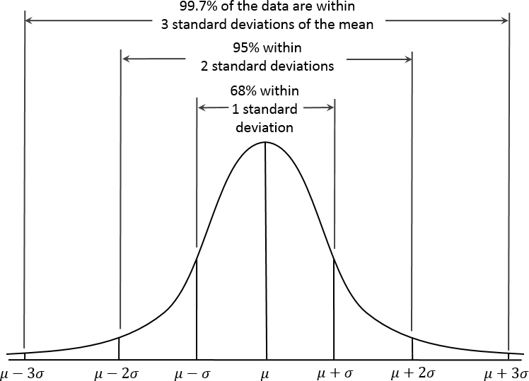
In a normal distribution (Figure 2-10), 68% of the data lies within one standard deviation of the mean, and 95% lies within two standard deviations.
The normal distribution is also referred to as a Gaussian distribution. Another name previously used for the normal distribution was the “error” distribution.
Statistically speaking, an error is the difference between an actual value and a statistical estimate like the sample mean. For example, the standard deviation is based on the errors from the mean of the data. Gauss’s development of the normal distribution came from his study of the errors of astronomical measurements that were found to be normally distributed.
Figure 2-10. Normal curve

Slide 24
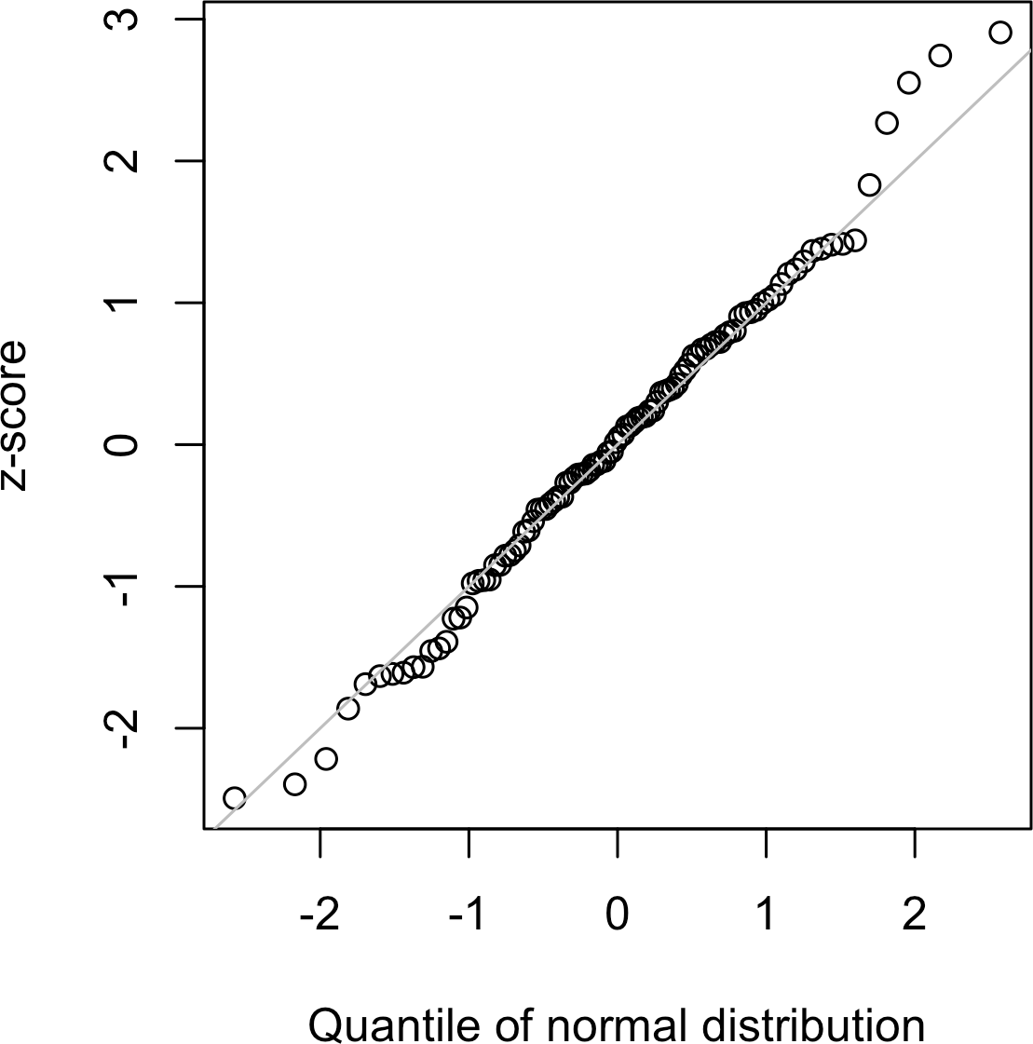
A QQ-Plot is used to visually determine how close a sample is to a specified distribution— in this case, the normal distribution. The QQ-Plot orders the z-scores from low to high and plots each value’s z-score on the y-axis; the x-axis is the corresponding
quantile of a normal distribution for that value’s rank. Since the data is normalized, the units correspond to the number of standard deviations away from the mean. If the points roughly fall on the diagonal line, then the sample distribution can be considered close to normal. Figure 2-11 shows a QQ-Plot for a sample of 100 values randomly generated from a normal distribution; as expected, the points closely follow the line. This figure can be produced in R with the qqnorm function:
In Python, use the method scipy.stats.probplot to create the QQ-Plot:
fig, ax = plt.subplots(figsize=(4, 4))
norm_sample = stats.norm.rvs(size=100)
stats.probplot(norm_sample, plot=ax)
Figure 2-11. QQ-Plot of a sample of 100 values drawn from a standard normal distribution

Slide 25
Long-Tailed Distributions
Key Terms for Long-Tailed Distributions
Tail
The long narrow portion of a frequency distribution, where relatively extreme values occur at low frequency.
Skew
Where one tail of a distribution is longer than the other.
Despite the importance of the normal distribution historically in statistics, and in contrast to what the name would suggest, data is generally not normally distributed.
While the normal distribution is often appropriate and useful with respect to the distribution of errors and sample statistics, it typically does not characterize the distribution of raw data. Sometimes, the distribution is highly skewed (asymmetric), such as with income data; or the distribution can be discrete, as with binomial data. Both symmetric and asymmetric distributions may have long tails. The tails of a distribution correspond to the extreme values (small and large). Long tails, and guarding against them, are widely recognized in practical work. Nassim Taleb has proposed the black swan theory, which predicts that anomalous events, such as a stock market crash, are much more likely to occur than would be predicted by the normal distribution.

Slide 26
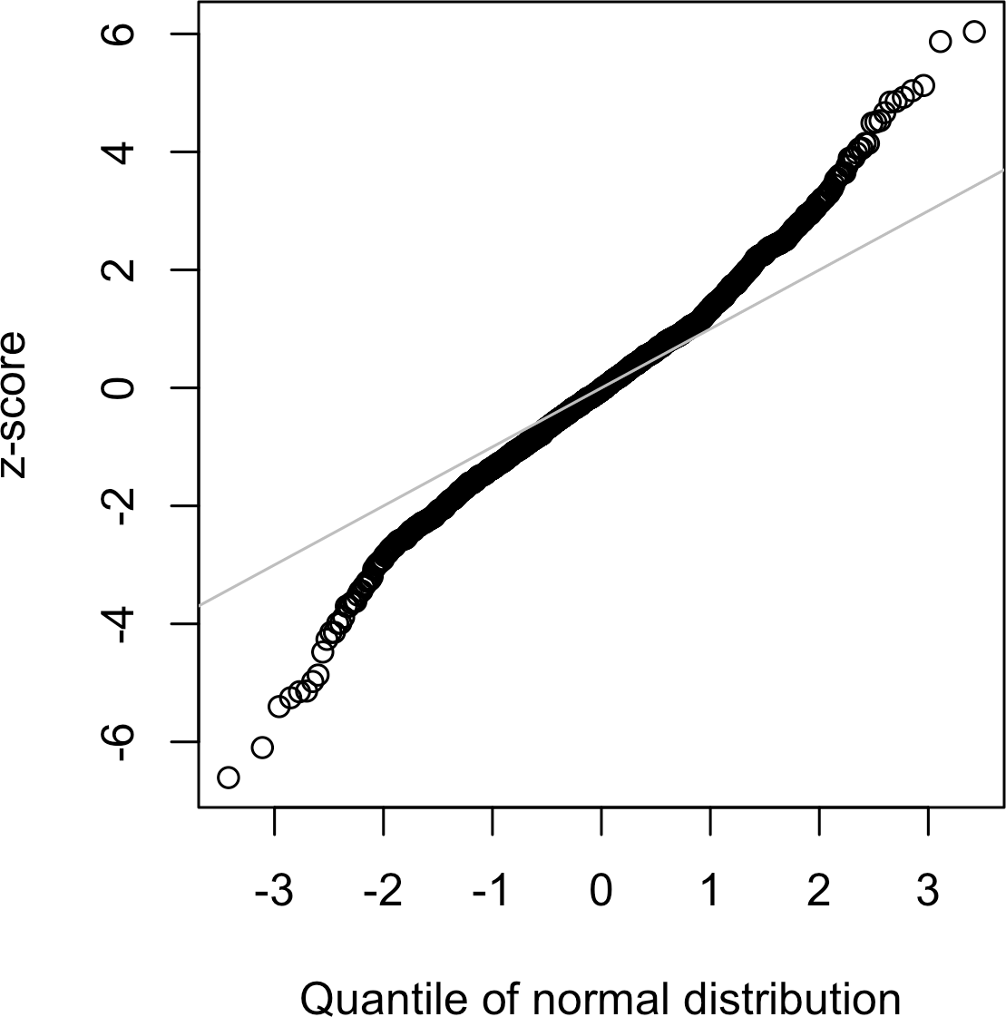
The corresponding Python code is:
nflx = sp500_px.NFLX
nflx = np.diff(np.log(nflx[nflx>0]))
fig, ax = plt.subplots(figsize=(4, 4))
stats.probplot(nflx, plot=ax)
Figure 2-12. QQ-Plot of the returns for Netflix (NFLX)

Slide 27
Student’s t-Distribution
The t-distribution is a normally shaped distribution, except that it is a bit thicker and longer on the tails. It is used extensively in depicting distributions of sample statistics.
Distributions of sample means are typically shaped like a t-distribution, and there is a family of t-distributions that differ depending on how large the sample is. The larger the sample, the more normally shaped the t-distribution becomes. Key Terms for Student’s t-Distribution
n
Sample size.
Degrees of freedom (n-1)
A parameter that allows the t-distribution to adjust to different sample sizes, statistics,
and numbers of groups.
The t-distribution is often called Student’s t because it was published in 1908 in Biometrika by W. S. Gosset under the name “Student.” Gosset’s employer, the Guinness brewery, did not want competitors to know that it was using statistical methods, so it insisted that Gosset not use his name on the article.
Gosset wanted to answer the question “What is the sampling distribution of the mean of a sample, drawn from a larger population?” He started out with a resampling experiment—drawing random samples of 4 from a data set of 3,000 measurements of criminals’ height and left-middle-finger length. (This being the era of eugenics, there was much interest in data on criminals, and in discovering correlations between criminal tendencies and physical or psychological attributes.) Gosset plotted the standardized results (the z-scores) on the x-axis and the frequency on the y-axis. Separately, he had derived a function, now known as Student’s t, and he fit this function over the sample results, plotting the comparison

Slide 28
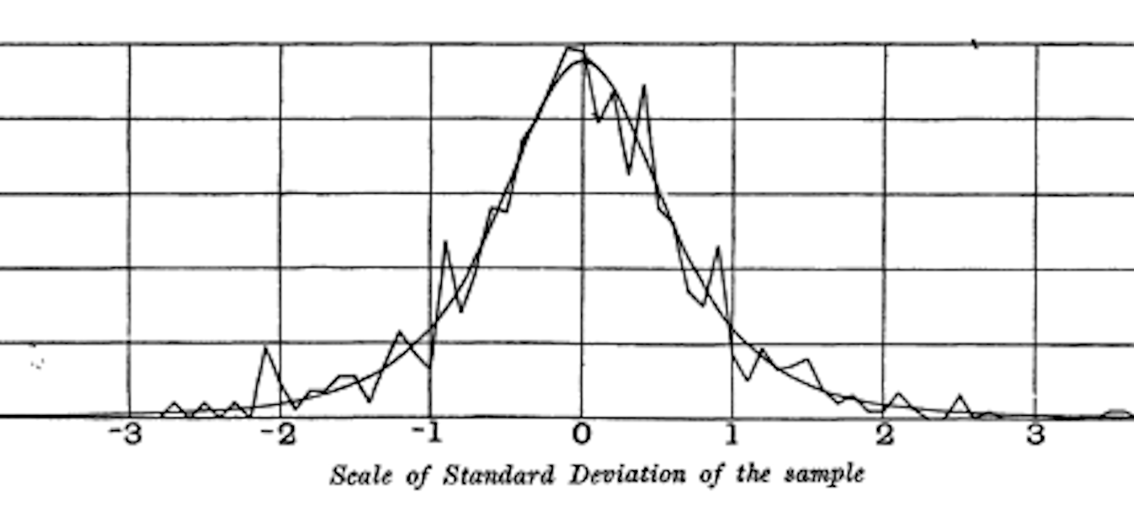
A number of different statistics can be compared, after standardization, to the tdistribution, to estimate confidence intervals in light of sampling variation. Consider a sample of size n for which the sample mean x has been calculated. If s is the sample standard deviation, a 90% confidence interval around the sample mean is given by:
Figure 2-13. Gosset’s resampling experiment results and fitted t-curve (from his 1908 Biometrika paper)

Slide 29

Binomial Distribution
Yes/no (binomial) outcomes lie at the heart of analytics since they are often the culmination of a decision or other process; buy/don’t buy, click/don’t click, survive/die, and so on. Central to understanding the binomial distribution is the idea of a set of trials, each trial having two possible outcomes with definite probabilities.
For example, flipping a coin 10 times is a binomial experiment with 10 trials, each trial having two possible outcomes (heads or tails); see Figure 2-14. Such yes/no or 0/1 outcomes are termed binary outcomes, and they need not have 50/50 probabilities.
Any probabilities that sum to 1.0 are possible. It is conventional in statistics to term the “1” outcome the success outcome; it is also common practice to assign “1” to the more rare outcome. Use of the term success does not imply that the outcome is desirable or beneficial, but it does tend to indicate the outcome of interest. For example, loan defaults or fraudulent transactions are relatively uncommon events that we may be interested in predicting, so they are termed “1s” or “successes.”

Slide 30
Key Terms for Binomial Distribution
Trial
An event with a discrete outcome (e.g., a coin flip).
Success
The outcome of interest for a trial.
Synonym
“1” (as opposed to “0”)
Binomial
Having two outcomes.
Synonyms
yes/no, 0/1, binary
Binomial trial
A trial with two outcomes.
Synonym
Bernoulli trial
Binomial distribution
Distribution of number of successes in x trials.
Synonym
Bernoulli distribution

Slide 31
The binomial distribution is the frequency distribution of the number of successes (x) in a given number of trials (n) with specified probability (p) of success in each trial.
There is a family of binomial distributions, depending on the values of n and p. The binomial distribution would answer a question like:
If the probability of a click converting to a sale is 0.02, what is the probability of
observing 0 sales in 200 clicks?
would return 0.0729, the probability of observing exactly x = 2 successes in size = 5 trials, where the probability of success for each trial is p = 0.1. For our example above, we use x = 0, size = 200, and p = 0.02. With these arguments, dbinom returns a probability of 0.0176.
The scipy.stats module implements a large variety of statistical distributions. For the binomial distribution, use the functions stats.binom.pmf and stats.binom.cdf:
stats.binom.pmf(2, n=5, p=0.1)
stats.binom.cdf(2, n=5, p=0.1)
The mean of a binomial distribution is n × p; you can also think of this as the expected number of successes in n trials, for success probability = p.
The variance is n × p (1 − p) . With a large enough number of trials (particularly when p is close to 0.50), the binomial distribution is virtually indistinguishable from the normal distribution.

Slide 32
Chi-Square Distribution
An important idea in statistics is departure from expectation, especially with respect to category counts. Expectation is defined loosely as “nothing unusual or of note in the data” (e.g., no correlation between variables or predictable patterns). This is also termed the “null hypothesis” or “null model”.
For example, you might want to test whether one variable (say, a row variable representing gender) is independent of another (say, a column variable representing “was promoted in job”), and you have counts of the number in each of the cells of the data table.
The statistic that measures the extent to which results depart from the null expectation of independence is the chi-square statistic. It is the difference between the observed and expected values, divided by the square root of the expected value, squared, then summed across all categories. This process standardizes the statistic so it can be compared to a reference distribution. A more general way of putting this is to note that the chi-square statistic is a measure of the extent to which a set of observed values “fits” a specified distribution (a “goodness-of-fit” test). It is useful for determining whether multiple treatments (an “A/B/C… test”) differ from one another in their effects.
The chi-square distribution is the distribution of this statistic under repeated resampled draws from the null model.

Slide 33
F-Distribution
A common procedure in scientific experimentation is to test multiple treatments across groups—say, different fertilizers on different blocks of a field. This is similar to the A/B/C test referred to in the chi-square distribution (see “Chi-Square Distribution”), except we are dealing with measured continuous values rather than counts. In this case we are interested in the extent to which differences among group means are greater than we might expect under normal random variation. The Fstatistic measures this and is the ratio of the variability among the group means to the variability within each group (also called residual variability). This comparison is termed an analysis of variance . The distribution of the Fstatistic is the frequency distribution of all the values that would be produced by randomly permuting data in which all the group means are equal (i.e., a null model).
The calculation of F is illustrated in the section on ANOVA. The F-statistic is also used in linear regression to compare the variation accounted for by the regression model to the overall variation in the data. F-statistics are produced automatically Python as part of regression and ANOVA routines.

Slide 34
Poisson and Related Distributions
Many processes produce events randomly at a given overall rate—visitors arriving at a website, or cars arriving at a toll plaza (events spread over time); imperfections in a square meter of fabric, or typos per 100 lines of code (events spread over space).
Key Terms for Poisson and Related Distributions
Lambda
The rate (per unit of time or space) at which events occur.
Poisson distribution
The frequency distribution of the number of events in sampled units of time or space.
Exponential distribution
The frequency distribution of the time or distance from one event to the next event.
Weibull distribution
A generalized version of the exponential distribution in which the event rate is allowed to shift over time.

Slide 35
Poisson Distributions
From prior aggregate data (for example, number of flu infections per year), we can estimate the average number of events per unit of time or space (e.g., infections per day, or per census unit). We might also want to know how different this might be from one unit of time/space to another. The Poisson distribution tells us the distribution
of events per unit of time or space when we sample many such units. It is useful when addressing queuing questions such as “How much capacity do we need to be 95% sure of fully processing the internet traffic that arrives on a server in any fivesecond period?”
The key parameter in a Poisson distribution is λ, or lambda. This is the mean number of events that occurs in a specified interval of time or space. The variance for a Poisson distribution is also λ.
The corresponding scipy function is stats.poisson.rvs:
stats.poisson.rvs(2, size=100)
This code will generate 100 random numbers from a Poisson distribution with λ = 2.
For example, if incoming customer service calls average two per minute, this code will simulate 100 minutes, returning the number of calls in each of those 100 minutes.

Slide 36
Exponential Distribution
Using the same parameter λ that we used in the Poisson distribution, we can also model the distribution of the time between events: time between visits to a website or between cars arriving at a toll plaza. It is also used in engineering to model time to failure, and in process management to model, for example, the time required per service call.
In the function stats.expon.rvs, the order of the arguments is reversed:
stats.expon.rvs(0.2, size=100)
This code would generate 100 random numbers from an exponential distribution where the mean number of events per time period is 0.2. So you could use it to simulate 100 intervals, in minutes, between service calls, where the average rate of incoming calls is 0.2 per minute.
Estimating the Failure Rate
In many applications, the event rate, λ, is known or can be estimated from prior data. However, for rare events, this is not necessarily so. Aircraft engine failure, for example, is sufficiently rare (thankfully) that, for a given engine type, there may be little data on which to base an estimate of time between failures. With no data at all, there is little basis on which to estimate an event rate. However, you can make some guesses: if no events have been seen after 20 hours, you can be pretty sure that the rate is not 1 per hour. Via simulation, or direct calculation of probabilities, you can assess different hypothetical event rates and estimate threshold values below which the rate is very unlikely to fall. If there is some data but not enough to provide a precise, reliable estimate of the rate, a goodness-of-fit test can be applied to various rates to determine how well they fit the observed data.

Slide 37
Weibull Distribution
In many cases, the event rate does not remain constant over time. If the period over which it changes is much longer than the typical interval between events, there is no problem; you just subdivide the analysis into the segments where rates are relatively constant, as mentioned before. If, however, the event rate changes over the time of the interval, the exponential (or Poisson) distributions are no longer useful. This is likely to be the case in mechanical failure—the risk of failure increases as time goes by. The Weibull distribution is an extension of the exponential distribution in which the event rate is allowed to change, as specified by a shape parameter, β. If β > 1, the probability of an event increases over time; if β < 1, the probability decreases. Because the Weibull distribution is used with time-to-failure analysis instead of event rate, the second parameter is expressed in terms of characteristic life, rather than in terms of the rate of events per interval. The symbol used is η, the Greek letter eta. It is also called the scale parameter.
With the Weibull, the estimation task now includes estimation of both parameters, β and η. Software is used to model the data and yield an estimate of the best-fitting Weibull distribution.
For example, the following code would generate 100 random numbers (lifetimes) from a Weibull distribution with shape of 1.5 and characteristic life of 5,000:
To achieve the same in Python, use the function stats.weibull_min.rvs:
stats.weibull_min.rvs(1.5, scale=5000, size=100)

